Slide 1


re
PolyUrbanWaters-Symposium 2024
Advancing Water-Sensitive Transformation in
Southeast Asian Cities
Challenges of rapid urban transformations
Curt Garrigan
Chief, Sustainable Urban Development Section, Environment and Development Division

Slide 2
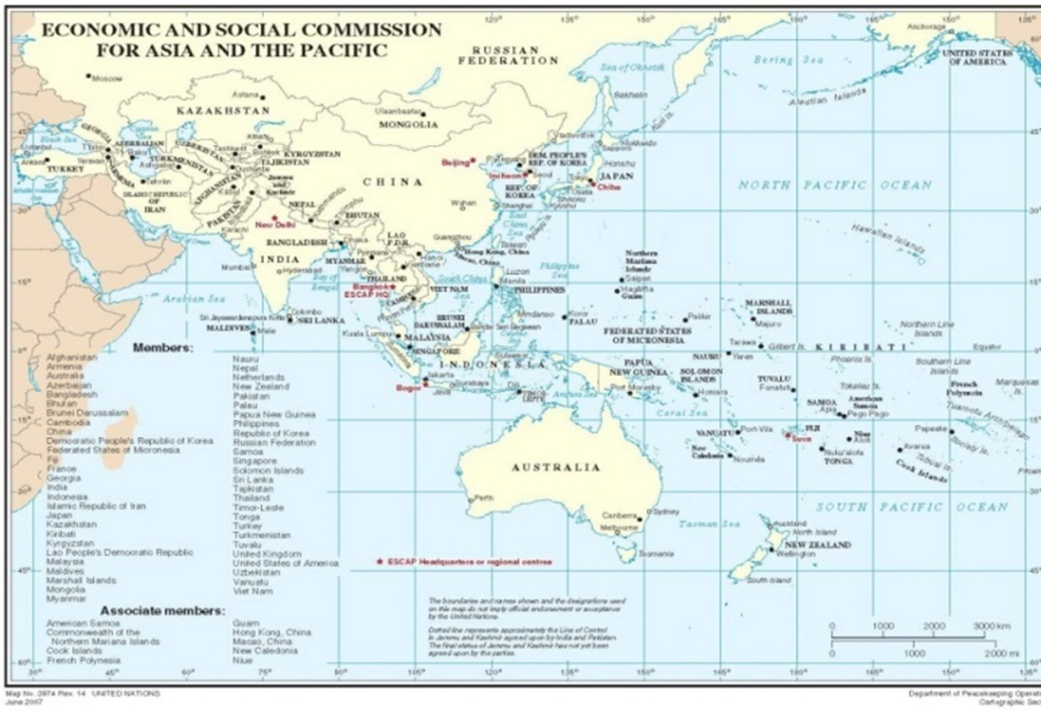
UNESCAP : The regional arm of the UN for Asia-Pacific
The United Nations Economic and Social Commission for Asia and the Pacific was established in 1947
Part of UN Secretariat: 53 member states and 9 associate members
ESCAP covers the world’s most populous region - two thirds of humanity
Based in Bangkok, with 4 Sub-regional offices
ESCAP works to strengthen regional cooperation to promote social & economic development
Engages with regional and global networks to promote implementation of global agendas on climate and sustainable development
Assists governments to implement policies that promote sustainable urban development and make efficient use of natural resources
Develops solutions to create safe, resilient, resource-efficient and sustainable cities and towns across the region
Notes:
In response and aligned with our mandate and subprogramme, we focus on four key/integrated areas.

Slide 3



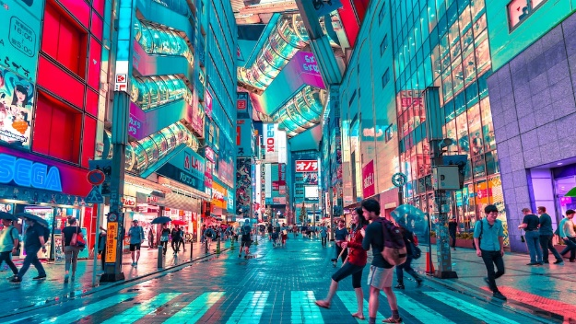


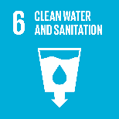


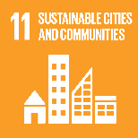
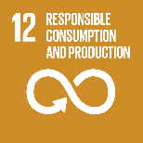
Focus of ESCAP Environment and Development Division (EDD)
Climate and clean air
Nature for people
Cities for a sustainable future
Sustainability transitions
Notes:
In response and aligned with our mandate and subprogramme, we focus on four key/integrated areas.

Slide 4



How do we work?
Enhancing regional collaboration to safeguard environmental commons
Intergovernmental support
Supporting governments at the local, subnational and national levels to strengthen skills, knowledge and tools to create sustainable futures.
Publishing reports, policy briefs, technical papers and manuals to capitalize up-to-date science for informed environmental policymaking.
Knowledge products and learning tools
Technical assistance and capacity building
Notes:
SDG 6

Slide 5








With whom do we work?
Academia and think tanks
National governments
Other UN agencies & development partners
Civil society organizations & stakeholders
Private sector
Youth
Notes:
SDG 6

Slide 6
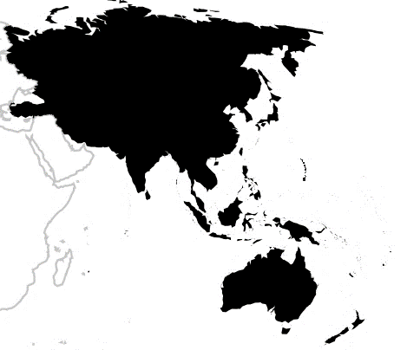











Cities climate action in China, India, Indonesia, Philippines, and Thailand
Where do we work?
Some examples
Waste management project in Kyrgyzstan
Air pollution projects in Indonesia, Maldives, and Thailand
GHG emission inventories in Central Asia
Supporting environment strategy of Bhutan
Sustainable food-energy-water management in Uzbekistan and Kazakhstan
Eco-labeling project in Cambodia
Tackling industrial water pollution in Bangladesh
SDG 14 Accelerator in Samoa and other SIDS
Supporting environmental rights strengthening in ASEAN countries
Supporting voluntary local reviews in Australia, Japan, Indonesia, Malaysia, Thailand, and others
53 Member States +
9 Associate Members
Supporting agroecology transitions in Cambodia, Lao PDR, Thailand and Viet Nam
Notes:
SDG 6

Slide 7
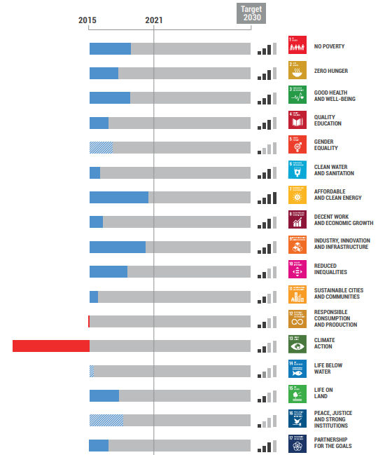
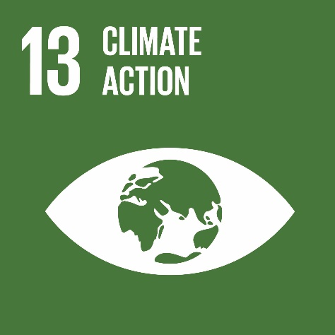





Asia and the Pacific performs poorly on environmental SDGs
Source: ESCAP (2022) SDG Progress Report
Notes:
AP’s economic and social development over recent decades has been accompanied by significant environmental challenges-increasing emissions and air pollution, overconsumption of natural resources/decrease in resource efficiency, as well as biodiversity loss, environmental degradation.
This is reflected as well in ESCAP’s SDG analysis where progress in environmental SDGs lags significantly.

Slide 8
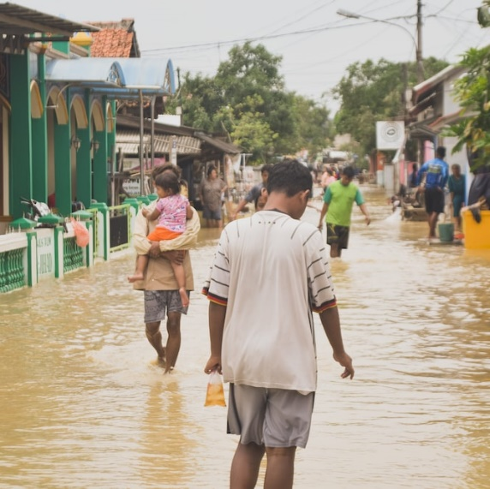
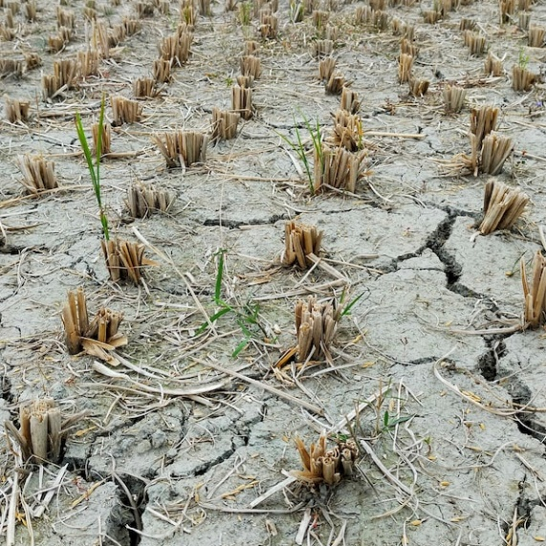
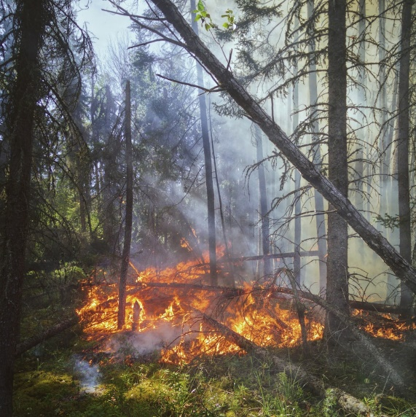


Climate crisis in Asia and the Pacific
Climate and clean air
Over the past 60 years, temperatures in Asia & Pacific have increased faster than the global mean.
Extreme, unpredictable weather events and natural hazards have become more frequent and intense.
6 of the top 10 countries most affected by these disasters are in the Asia-Pacific region, where food systems are disrupted, economies damaged and societies undermined, impacting the most vulnerable populations.
Nature for people
Cities
Sustainability transitions
Notes:
Climate change remains an existential crisis for the Asia-Pacific developing countries. Nowhere is the urgent need for enhanced climate ambition and action more apparent than in the Asia-Pacific region, where climate change and climate-induced disasters are increasingly and continuously threatening development, often undermining hard-won development gains and exacerbating underlying drivers of poverty and societal inequalities by disproportionately burdening the poor and other vulnerable groups.
While the last ten years were marked with severe impacts of natural disasters on the region, the Asia-Pacific countries experienced unprecedented climate-induced disasters, including heatwaves, droughts, typhoons and floods in 2022. Studies show that the consequences of climate change have increasing impacts on women and children, who are more vulnerable to extreme weather events and less resilient in the recovery and reconstruction processes. Therefore, additional efforts should be made to integrate gender-sensitive policies and to develop capacities in member States to address the additional burdens of vulnerable groups.

Slide 9
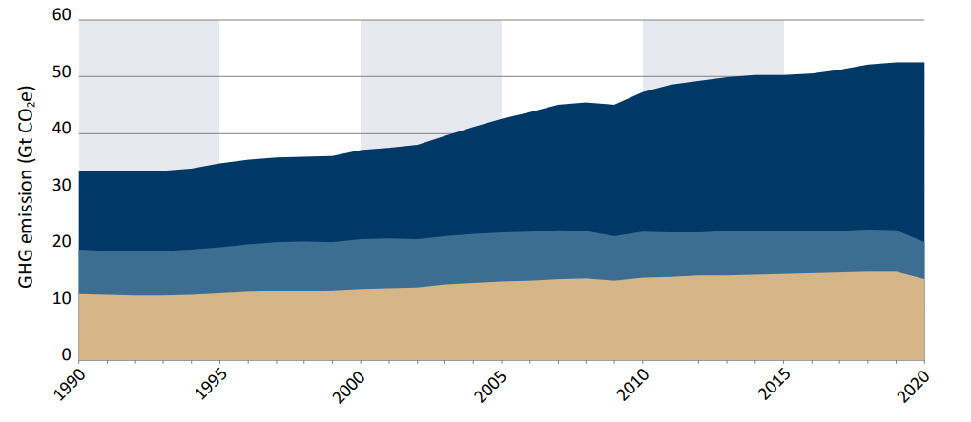



Asia and the Pacific contributes to over 55% of the global greenhouse gas (GHG) emissions with increasing trends
Climate and clean air
Greenhouse gas emissions trends in the Asia-Pacific region compared to the rest of the world, 1990–2020 (GtCO2e)
Nature for people
Major sources of GHG emissions in Asia and the Pacific
Emissions from Asia & Pacific
Cities
Emissions from USA, France, Netherlands, UK
Electricity and heating
Manufacturing and construction
Transportation
Emissions from the rest of the world
Sustainability transitions
Source: IPCC (2022) AR6 Synthesis report
Notes:
Furthermore, the region accounted for more than half of global greenhouse gas emissions, a share that is still increasing owing to the fossil fuel-intensive development pathways that many countries in the region are following. These challenges require strengthened and informed decision-making, with due access to information, public participation and justice on climate-related matters, as well as more ambitious strategies integrating mitigation and adaptation approaches.

Slide 10
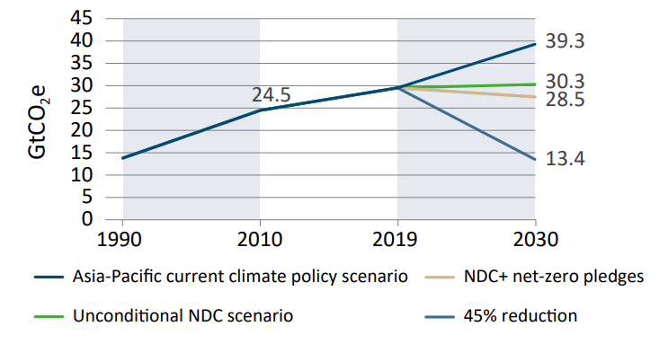
There is an urgent need to reverse the current emission trend in Asia & Pacific
Climate and clean air
Current NDC Commitments
Greenhouse gas emissions scenarios with compounded nationally determined contribution and carbon neutral pledges for the Asia-Pacific region, 1990-2030
+16 %
1.5°C target
Global GHG emissions must be reduced by 45% by 2030 compared to 2010 levels to keep the 1.5°C target in alignment with the Paris Agreement.
Nature for people
-45%
Over 1.5°C
1.5°C
Cities
Sustainability transitions
2010
emissions
2030 emissions
Source: IPCC (2022) AR6 Synthesis report
Notes:
Countries in Asia and the Pacific collectively emitted 31.6 GtCO2e in 2020. Current nationally determined contributions (NDCs) commitments for greenhouse gas emission reduction and regional greenhouse emissions trajectories are projected to result in greenhouse gas emissions of 25.2 GtCO2e in 2030. As shown in figure 1.4, this represents a 16 per cent increase from 2010 levels, rather than the 45 per cent reduction required to achieve the 1.5°C pathway.
The current gap in the regional NDC commitments needs to be addressed at the national level to avoid a large overshoot.
Collective efforts are required to spur the region’s mitigation ambition and support the mid-century climate neutrality trajectory that would keep the region within the 1.5°C target.

Slide 11
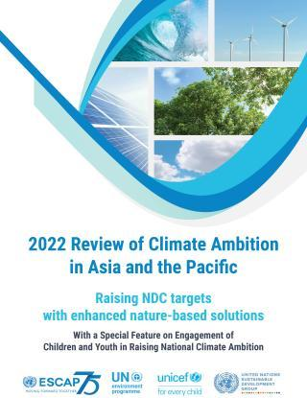

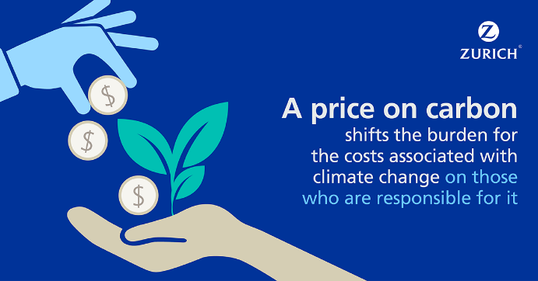
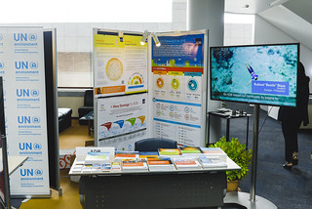
How does EDD address climate change?
Climate and clean air
Annual assessment reports
Nature for people
Capacity building/advisory services and e-learning
Supporting Asian-Pacific countries to raise climate ambition and action to meet the Paris Agreement and other goals
Carbon pricing simulation tool
Cities
Climate finance
Sustainability transitions
Asia-Pacific Climate Week
Notes:
Supporting member states to raise climate ambition and action. Key activities include:
• Annual assessment report: 2022 Review of Climate Ambition in Asia and the Pacific: Raising NDC targets with enhanced nature-based solutions.
• Training guide book: Accelerating Implementation of the Paris Agreement in Asia-Pacific: A Guide for Policymakers (2021).
• Carbon Pricing Simulation tool: identifying the impacts of carbon pricing on various macroeconomic factors and supporting NDC implementation and carbon neutrality targets.
• E-learning course: Methodologies for GHG Emissions Inventories and Paris Agreement Reporting (partnership with IGCE).
• Asia-Pacific Climate Week: voicing recommendations and supporting actions from the Asia-Pacific region on issues such as climate finance, nature-based solutions, and energy and industry transition in preparations for the UN Secretary General’s Climate Summit as well as building regional momentum for the UN Climate Change Conferences.
• Climate Finance: Partnering with the UN Climate Change Secretariat (UNFCCC) on the Needs-based Finance project to enhance Asian-Pacific countries’ access and mobilization of climate finance; and supporting Regional Dialogues on Carbon Pricing (REdiCAP) organized under the UNFCCC Collaborative Instruments for Ambitious Climate Action (CiACA) workstream.

Slide 12












Air pollution in Asia and the Pacific
Climate and clean air
Where does air pollution come from?
Domestic burning of biofuels and biomass
Fossil fuels combustion for producing energy
and electricity
Vehicle emissions
Industrial and construction activities
Biomass burning in agricultural land
Did you know?
92% of population in Asia and the Pacific is breathing unhealthy air.
Nature for people
Cities
What are the impacts of air pollution?
Health impacts
Inequalities
Climate change
Economic impacts
Food production
Sustainability transitions
Icons from freepik/flaticon

Slide 13
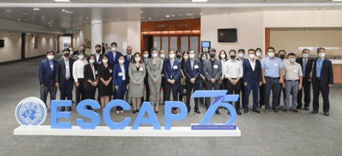
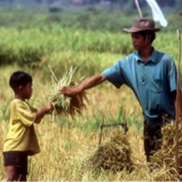

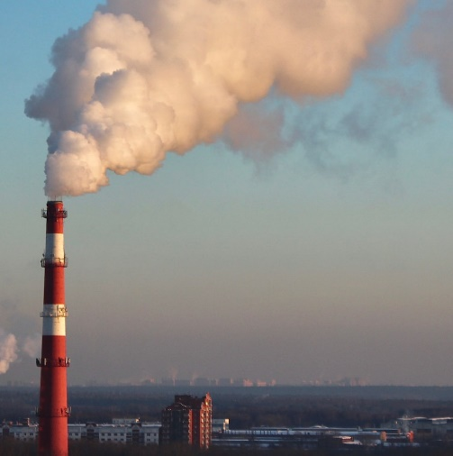
How does EDD address air pollution?
Climate and clean air
Building the Pan-Asia Partnership for Geospatial Air Pollution Information Program
Mechanization Solutions for Integrated Management of Straw Residue and Air Pollution Monitoring
Nature for people
Cities
Urban Air Pollution Projects
Implementing pilot projects
Air Sheds in Asia
City Level Action Plans
(Procurement of air quality sensors and air filters, to bolster air quality measuring and monitoring capacity in cities)
Sustainability transitions
Notes:
• Providing tools to support cities in making evidence-based decisions on urban air pollution reduction, using innovative data, machine learning modelling systems, and forecasting methodologies, such as the Building the Pan-Asia Partnership for Geospatial Air Pollution Information Program.
• Supporting city-level air pollution mitigation policies with the procurement of air quality sensors and air filters, to bolster air quality measuring and monitoring capacity and harm-reduction initiatives through the Urban Air Pollution Project.
• Strengthening regional collaboration and local action on air pollution through a regional modality, such the Urban Air Pollution Project Action Planning Workshop, and the 2nd Online Research Symposium on Air Pollution.
• Implementing pilot projects including, Mechanization Solutions for Integrated Management of Straw Residue and Air Pollution Monitoring, among others.

Slide 14

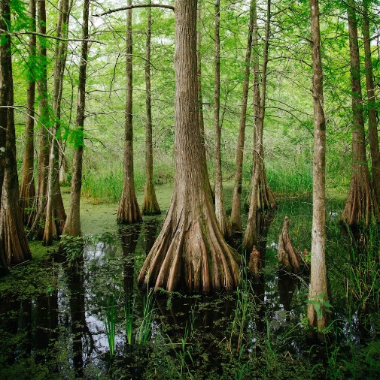
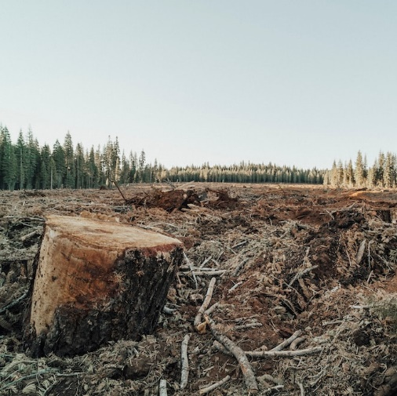
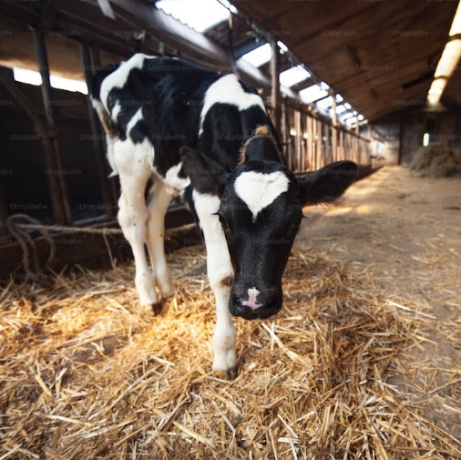

Nature in Asia and the Pacific – key facts
Climate and clean air
Nature for people
Cities
40%
of the Asia-Pacific’s coral reefs have already disappeared
60%
mangroves in Asia and the Pacific have been cleared
75%
of forest area lost in Asia-Pacific is due to conversion to cropland
24%
of Asia’s total GHG emissions come from the agri-food sector
91%
of freshwater is used for agriculture in South Asia
Sustainability transitions
Notes:
• Hosting Asia-Pacific Day for the Ocean annually to promote the engagement of all stakeholders, including civil society, the youth, academia, the private sector and the scientific community for the conservation and sustainable use of the oceans, seas and marine resources.
• Hosting the Regional Decade Program: Accelerating the delivery of SDG14 in Asia and the Pacific, in line with the UN Decade of Ocean Science for Sustainable Development (2021-2030) and through membership in UN-Oceans.
• Developing a SDG 14 accelerator tool to scope governance gaps and opportunities for prioritizing action in implementing SDG 14: life below water. The accelerator is designed as a strategic planning instrument for governments in the Asia-Pacific region operating in data-limited contexts.

Slide 15
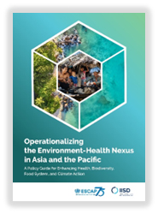
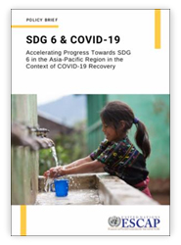
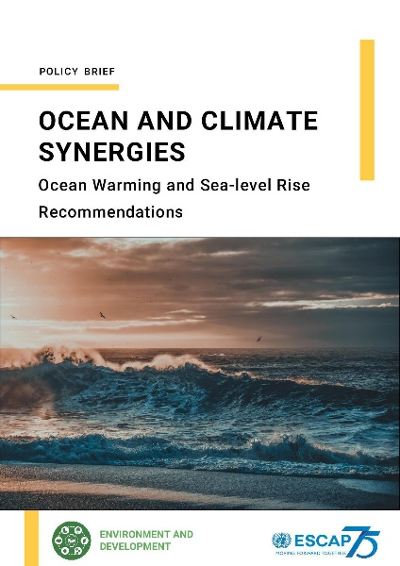

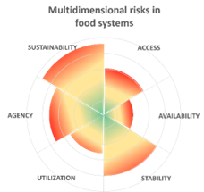

Nature-based solutions - what does EDD focus on ?
Climate and clean air
Environment-Health Nexus & One Health
Sustainable Water Management
Sustainable food systems
Ocean climate action
Agroecology and safe food systems transitions
Nature for people
Asia-Pacific Regional
Food System Dialogue & Stocktake
Food System risk Assessment
Cities
Sustainability transitions
Notes:
• Hosting the Asia-Pacific Regional Food System Dialogue, in the lead up to the Food System Summit 2021, to raise awareness and strengthen regional cooperation and national action on food systems transformation.
• Supporting the Agroecology and Safe food System Transitions (ASSET) project (2020-2025) to promote agroecological transitions in South-East Asian countries, including hosting a multi-stakeholder dialogue and developing a policy guide in collaboration with ASEAN.
• Partnering with WFP and FAO to develop a framework to assess multidimensional risks in food systems in Asian-Pacific countries, in the context climate change, price shocks, conflicts and other dimensions of risks, with the aim to inform and strengthen the operation of food systems transformation pathways from a risk perspective.

Slide 16
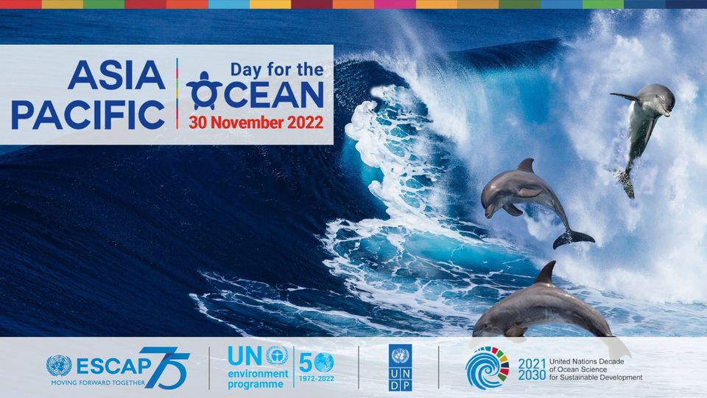


Protecting our ocean - what does EDD focus on ?
Climate and clean air
Nature for people
Asia-Pacific Day for the Ocean
Regional Ocean Decade
SDG 14 Accelerator Tool
Cities
Sustainability transitions
Notes:
• Hosting Asia-Pacific Day for the Ocean annually to promote the engagement of all stakeholders, including civil society, the youth, academia, the private sector and the scientific community for the conservation and sustainable use of the oceans, seas and marine resources.
• Hosting the Regional Decade Program: Accelerating the delivery of SDG14 in Asia and the Pacific, in line with the UN Decade of Ocean Science for Sustainable Development (2021-2030) and through membership in UN-Oceans.
• Developing a SDG 14 accelerator tool to scope governance gaps and opportunities for prioritizing action in implementing SDG 14: life below water. The accelerator is designed as a strategic planning instrument for governments in the Asia-Pacific region operating in data-limited contexts.

Slide 17
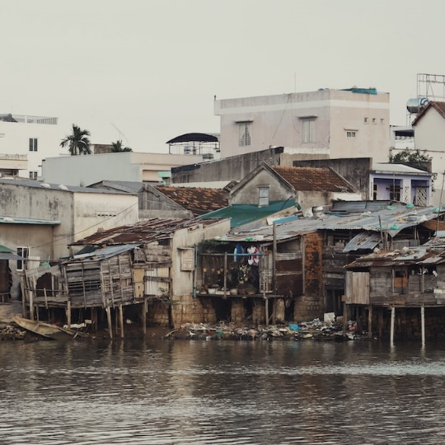
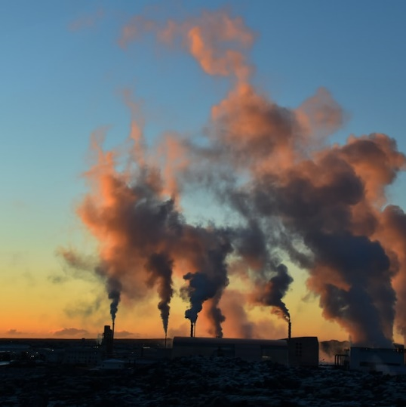
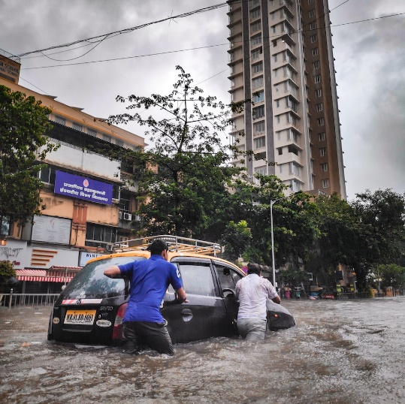
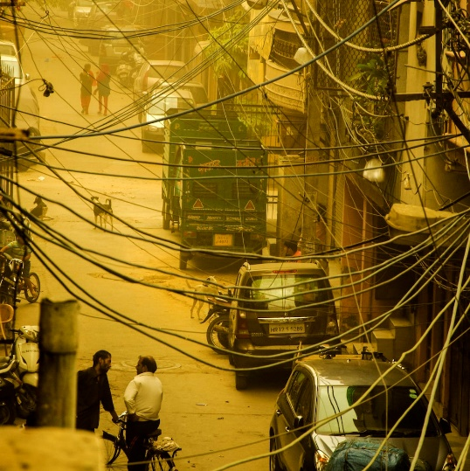
Cities in Asia and the Pacific – key facts
Climate and clean air
Nature for people
Cities
>50% of the Asia-Pacific population lives in urban areas and the number is expected to increase
~70%
of the region’s emissions come from urban areas
99 of the top 100 cities facing environmental risks are in the region
7 in every 10 cities in Asia suffer from poor air quality
Sustainability transitions

Slide 18
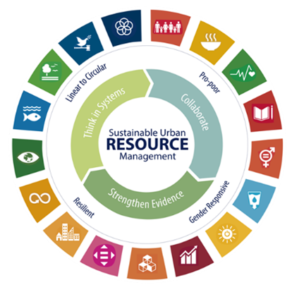
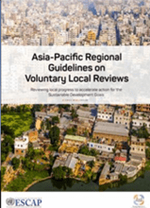
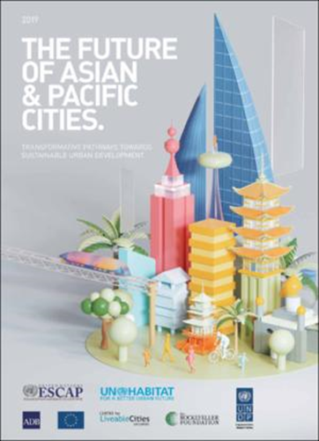
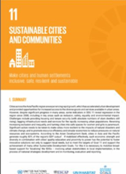
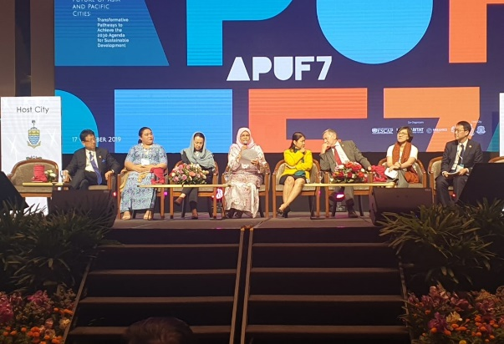
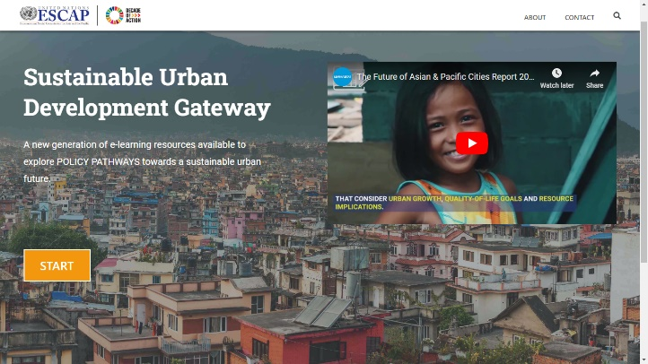
Cities for a sustainable future - what does EDD focus on ?
Climate and clean air
SDG localization and voluntary local reviews
Flagship reports on cities
Asia-Pacific Urban Forum
Nature for people
Cities
Sustainability transitions
Urban Gateway (e-learning resources available to explore POLICY PATHWAYS towards a sustainable urban future.)
Notes:
• Localizing the SDGs : translating the Global Goals into relevant, actionable and attainable priorities at the local level is a vital first step in leveraging action for addressing the multiple interlinked crises and promoting sustainable urban development.
• Voluntary Local Reviews (VLRs) : spreading awareness on the SDGs with local communities and accelerating uptake across all municipal departments, strengthening horizontal and vertical coordination, as well as more informed decision making.
• SDG 11 Under Review: a regional assessment of progress on SDG 11 at the Asia-Pacific Forum on Sustainable Development (APFSD) that will serve as an input to the High-Level Political Forum (HLPF).
• Held every four to five years, the Forum is the largest regional gathering of urban stakeholders, engaging policymakers from local and national governments, financial institutions, civil society, the academia, the urban training-research community and private sector to discuss innovative solutions, identify common actions and objectives and strengthen effective partnerships to achieve sustainable urban development.
• ESCAP’s fourth flagship ‘cities’ report, with previous iterations in 2011, 2015 and 2019, having been developed in partnership with other UN, multilateral, and non-government entities will be launched in October 2023 – serving as the key background document for participants of the 8th Asia Pacific Urban Forum in Suwon City, Republic of Korea.

Slide 19
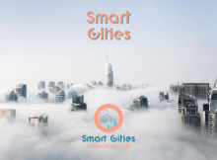

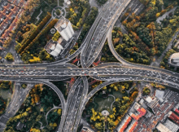

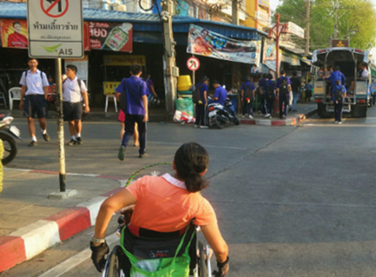


Cities for a sustainable future - what does EDD focus on ?
Climate and clean air
Smart Cities Innovation Lab
Asia Pacific Mayors Academy for Sustainable Urban Development
Cities and climate change
Forecasting Sustainable Urbanization
Nature for people
Cities
Leave no one behind in South Asian cities
Implementation of the New Urban Agenda
Closing the Loop
Sustainability transitions

Slide 20
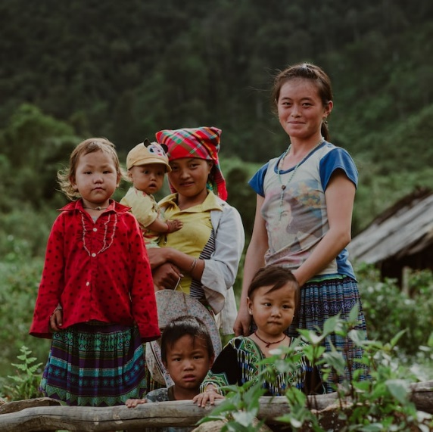

Sustainability transitions in Asia and the Pacific – key facts
Climate and clean air
Nature for people
Cities
Only 24 countries in the region recognize the right to a healthy environment in their constitutional provisions
Only 7% of all environment-related ministries have a female minister, against 12% globally
Sustainability transitions

Slide 21

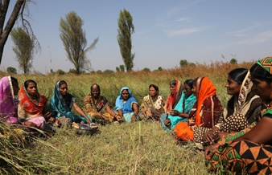


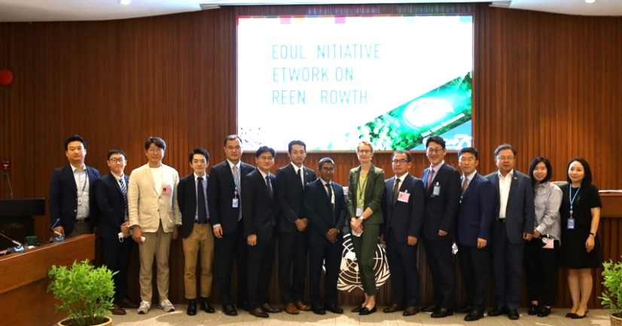
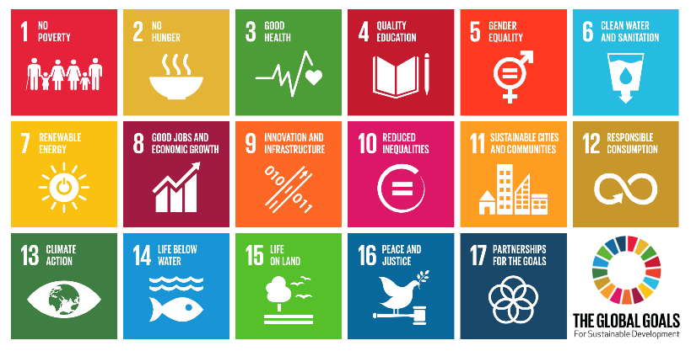
Sustainability transitions - what does EDD focus on ?
Climate and clean air
Strengthen environmental access right
Stakeholder engagement support
Participatory foresight
Behavioral science
Nature for people
Green growth
Agenda 2030 follow up and review
Cities
Seoul Initiative Network on Green Growth (SINGG)
Cambodia eco-labeling project
Sustainability transitions
Kyrgyzstan waste management project
Notes:
Green growth:
• A regional platform to exchange experiences and best practices on issues related to sustainable and inclusive growth through the annual Policy Consultation Forum of the Seoul Initiative Network on Green Growth (SINGG) project. The 18th Forum of the SINGG will be organized with the theme "Accelerating “Accelerating Collaborative Efforts for Climate Action in Asia and the Pacific” in October 2023.
• The SINGG supports pilot projects with over 44 projects in 22 countries implemented since 2005. The most recent include projects on Eco-labeling and waste management in Cambodia, LAO PDR and Kyrgyzstan.
Environmental governance:
• Strengthening environmental Access Right, including supporting the ASEAN Intergovernmental Commission on Human Rights (AICHR) in the development of an ASEAN Regional Environmental Rights Framework jointly with UNEP and OHCHR. Developing feasibility study on the Legal and Institutional Context in the Pacific: Towards the Development of a Sub-regional Instrument on Access Rights (2022)
• Stakeholder engagement support, including regional and international dialogue, professional development, planning and assessment tool on stakeholder engagement and technical assistance to countries producing Voluntary National Review reports. Coordinating the Youth Voices for Climate Action Campaign.
• Participatory foresight to explore drivers of systemic change in Asia and the Pacific and describe alternative futures. ESCAP team training in transformative futures, and a series of participatory workshops resulted in Asia-Pacific Futures in 2040: Raising Ambitions for a Healthy Environment (2022) and the Future of Asian and Pacific Cities 2019 reports.
• Systems thinking for policy planning, along with a series of national and SDG-focused analyses
• Behavioural science promotion, including self-paced E-learning introduction, and a series of briefs exploring application of “BeSci” in different contexts. This working paper: Applying Behavioural Science to Advance Environmental Sustainability provides an overview.
Agenda 2030 Follow Up and Review:
• Contributing to ESCAP’s overall support to countries in implementing the 2030 Agenda, including the organization of the annual Asia-Pacific Forum on Sustainable Development and the development of SDG profiles and Sustainable Development entry point profiles.
• Managing the Sustainable Development Goals Help Desk, one-stop online service providing access to SDG-related tools, knowledge products, data portals, expertise, advice and opportunities for peer-learning and regional cooperation on various thematic areas.

Slide 22
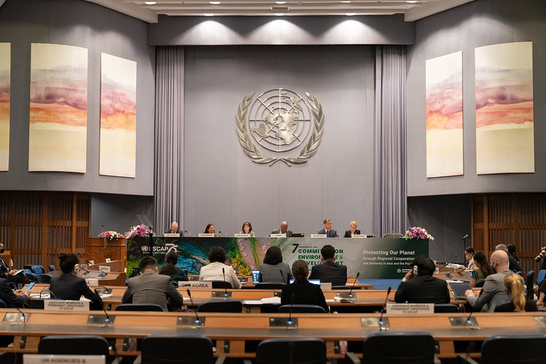
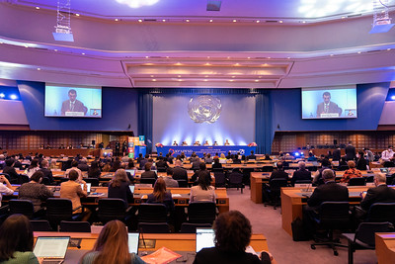
Committee on Environment and Development (bi-annual)
16-18 October 2024
Climate and clean air
ESCAP Commission session (April each year)
& Asia-Pacific Forum on Sustainable Development (annual)
Nature for people
Cities
Sustainability transitions

Slide 23
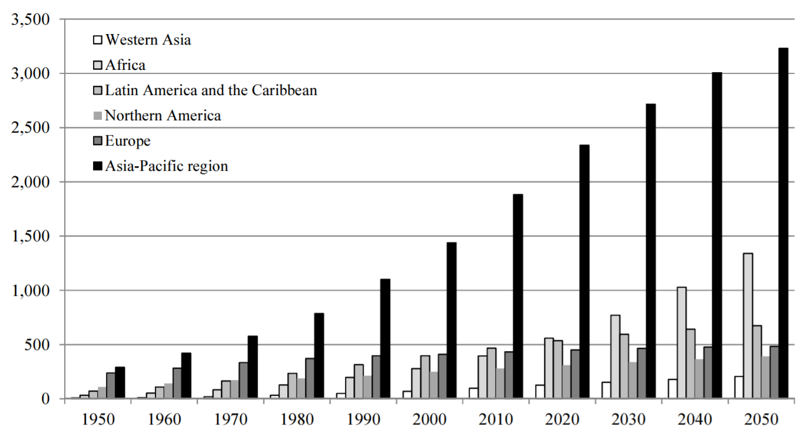
Projected growth in urban populations
From 2018 on, more people living in urban areas than rural areas
By 2050, 70% of the population will live in cities
95% of urban growth will be in developing countries (most in Asia and Africa)
More than 800 million people live in slums today- most in Eastern and South-Eastern Asia
Urban population at midyear (Thousands)

Slide 24
Urbanization Trend in Asia Pacific (Secondary Cities)

Slide 25

Challenges of Urbanization
Rapid urbanization: half of the Asia Pacific region‘s population is urban, representing 60 percent of global urban population; Half of the urban population in low-lying coastal areas
In many cities, the population is growing faster than the governments can build infrastructure improvements, such as water, sanitation and roads/bridges
Unplanned urban sprawl and increase in absolute number of slum-dwellers are consequences
60-80% of global energy consumption; 60-80 per cent of global emissions
Cities generate 75% of region‘s GHG emissions (mostly from energy supply and tranportation); Transport emissions have doubled since 1970
19 of top 20 most polluted cities in the world are in Asia
Urban areas generate more than 1.2 million tonnes of municipal solid waste/day; estimated to double by 2025;
Cities occupy only 3 per cent of the world’s land but consume 75 per cent of all natural resources, produce 50 per cent of all waste. Produce up to 80% of GDP
Many cities have weak urban planning and can‘t provide enough housing, or meet water and sanitation needs
Large unmet infrastructure needs; strained resources and environment impact
Notes:
25
Start with broad overview of situation in our region.

Slide 26
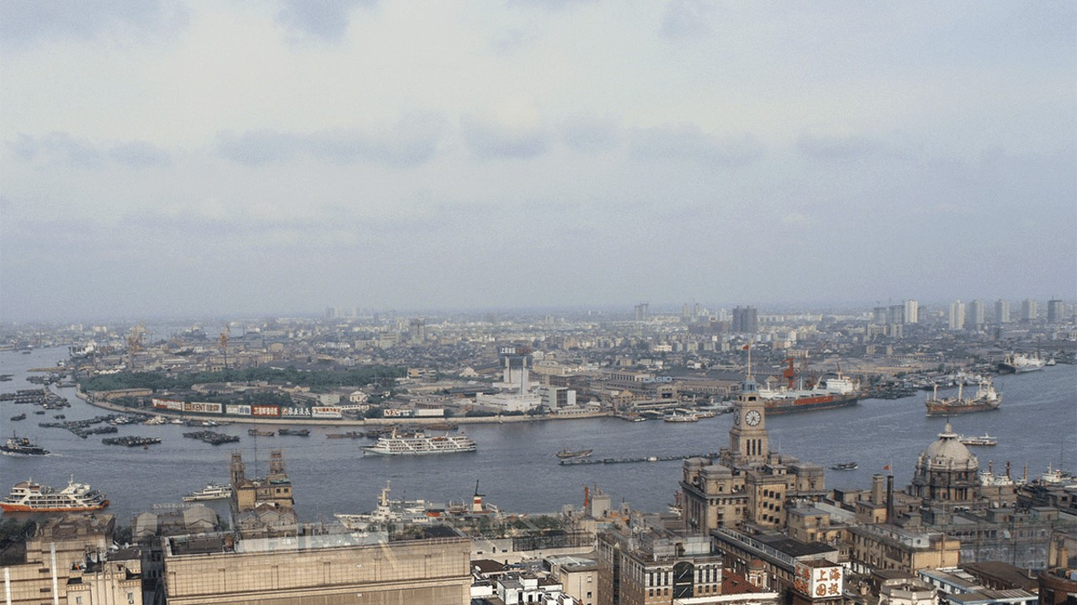
Shanghai, China 1987

Slide 27
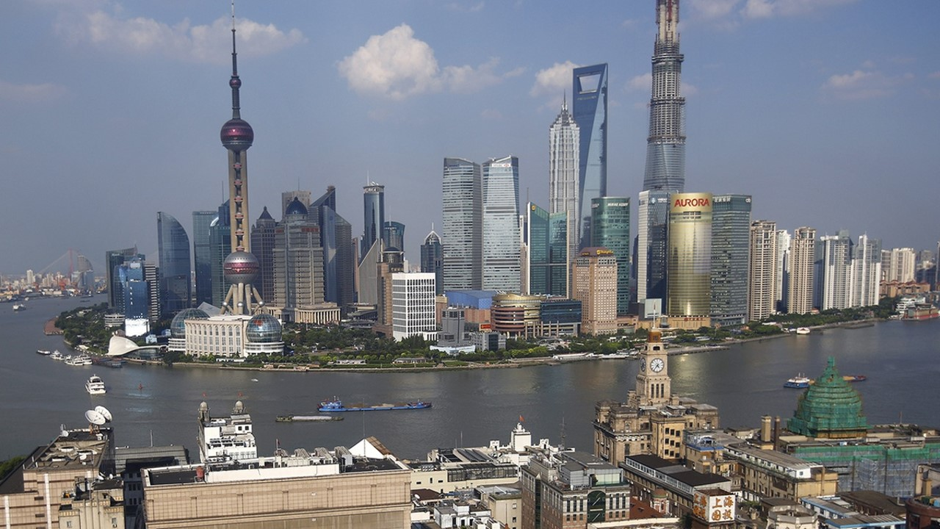
Shanghai, China 2013

Slide 28
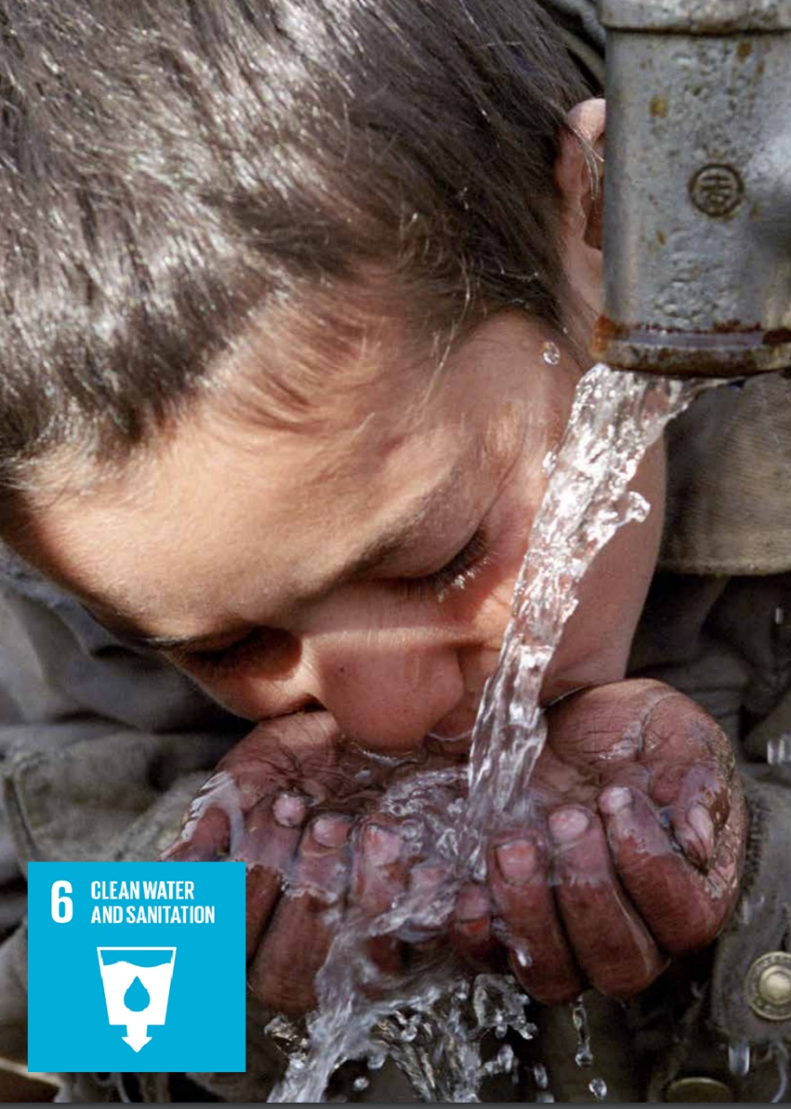
Impacts of urbanization (Water Resources)
Today, more people have access to safe drinking water (from 74% in 1990 to 94%); Access to sanitation increased from 44 to 65% (mostly in urban areas);
Wastewater treatment as low as 4%; Pollution and poor water quality are common problems
Many of the freshwater sources in Asia are already over-extracted
Increase in demand of 55% by 2030 for urban water, including in cities that already face water stress and scarcity;
Insufficient infrastructure to meet demand for domestic water, manufacturing, and thermal electricity generation.
More water is needed for food and energy (AI)
Shifting urban-rural water ratios.

Slide 29




Impacts of urbanization (Water Resources)
Source: World Bank
hindustantimes.com
https://www.azernews.az/nation/85086.html

Slide 30


Slide 31
Urban Growth in Asia-Pacific Cities- Land use change
Source: Rockefeller 100 Resilient Cities Initiative https://www.100resilientcities.org/planning-urban-growth-resilient-future/ 100 RC & Marron Institute
Notes:
https://www.100resilientcities.org/planning-urban-growth-resilient-future/
100 RC & Marron Institute
Cities in the region are expected to significantly increase in geographical size.
There is and will continue to be a huge demand for housing in the region’s cities, and with this projected urban expansion, lots of new houses will need to be built.
This provides opportunities for integrated and inclusive planning processes to increase the sustainability, resilience, inclusivity, and livability of cities in the region.

Slide 32


Urban Growth in Asia-Pacific Cities- Land and resources
Source: https://data.opendevelopmentmekong.net
Rapid and unplanned urbanization can potentially lead to environmental degradation, increased pressure on natural resources, generation of waste, exposure to pollution and disasters, and vulnerability to climate change.

Slide 33


Impacts of Urban Expansion- Phnom Penh in 2014
Displacement of agricultural land; reliance on more distant food sources, transport and refrigeration (more emissions)
Increased energy and resource demand
Urban Heat Island Effect- increased cooling demand (energy, water)
Expanded vehicular usage- emissions and air pollution
Stress on water resources – grey infrastructure; power; domestic, industrial and agricultural demands
  Impacts on aquifers and alteration of natural hydrology
  Inadequate storm management

Slide 34


Impacts of urbanization (Water Resources)

Slide 35





Asia-Pacific’s Sinking Cities
Shanghai
Tianjin
Dhaka
Chittagong
Karachi
Ho Chi Minh City
Bangkok
Mumbai
Manila
Jakarta
Perth
Source: ASIAN Correspondent https://asiancorrespondent.com/2018/11/4-sinking-asian-cities-that-could-be-drowned-by-climate-change/
Source: Eco-Business
Source: Asia.Nikkei.com

Slide 36
Why are cities in Asia sinking?
Rapid urbanization and development
Inadequate Land Use Planning; urban sprawl
Over-extraction of groundwater; poor urban water management systems
  Water withdrawals for industrial, manufacturing, domestic use
  Lack of monitoring systems
Multi-dimensional impacts of climate change
Land subsidence is generally
not incorporated in sea-level rise
modeling. Impacts may be more
accelerated.

Slide 37

Addressing Land Subsidence Issues
Mitigation and Adaptation measures are necessary
Comprehensive urban resilience strategies
Urban and Territorial Planning is critical to manage current and future development pressures
Integrated Water Resource Management (IWRM)
Monitoring systems (ground/subsurface and satellite)
North Jakarta has sunk 2.5m in 10 years and is continuing to sink by as much as 25cm a year in some parts, which is more than double the global average for coastal megacities.
Jakarta is sinking by an average of 1-15cm a year and almost half the city now sits below sea level.
Source: BBC

Slide 38

Addressing Land Subsidence Issues
Spatial Planning; Land use and zoning regulations; building regulations; protected areas
Integrated water resource management: Controlled groundwater withdrawals; harvesting water and recharging aquifers; water treatment and recycling
Infrastructure Investments- water facilities; water retention (sub-surface drainage; sponge city approaches); sea walls; deep wells)
Relocation is a last resort?

Slide 39

Priorities for the region
Greater awareness
  Consequences of unplanned development
  Over-extraction of groundwater
Identification/installation of monitoring systems
  Data-driven urban planning
  Remote sensing and satellite technologies
Community of Practice among cities/experts
  Identify best practices, capacity gaps
  Investment needs
Policy Development
  Integration with climate policies
  Regulations on buildings, groundwater
  Legislative and taxation mechanisms

Slide 40
THANK YOU
Follow us:
unescap
unitednationsescap
www.unescap.org
unescap
unescap
united-nations-escap
For more information, please visit the Environment and Development Division webpage https://www.unescap.org/our-work/environment-development and contact us as: ESCAP-EDD-EDPS@un.org

